Slide 1
Machine learning on raw user SMSes for Loan Risk Prediction
Under Guidance of : Dr. Manish Kumar
ABHISHEK JAISWAL

Slide 2
Abstract
Traditional loan taking process involves checking credit worthiness by pulling out one’s credit report and score from various sources and thus giving you credit score.
But, if you do not have regular income, proper documentation to show income flow or have never taken a loan before then getting a loan from a commercial bank may be difficult.
What to do??

Slide 3
To tackle this issue, non traditional data sources can be employed to build credit report, by using individual’s personal information or any data to measure their credit worthiness. For instance , a person’s SMS, emails, online transactions etc.
Financial state of a person can be judged from the SMS messages that you receive for your each transaction from telecom companies, banks and e-retailers etc.
Our project involves creating a useful data set by mining users SMS messages and predicting the credit worthiness and hence the loan risk factor by using Data Mining and Machine Learning approach.

Slide 4
Introduction
While other media may be used more than SMS to communicate, you still receive messages from various service providers such as telecom companies, banks and e-retailers. Companies will look at non-traditional data to assess consumer risk and determine the creditworthiness.
User SMS are mined to create a dataset for loan risk prediction. Various token and amounts are extracted to create attributes for dataset such as: total amount credited, debited, total amount recharged, Emi amount paid if loan has been taken by user etc.

Slide 5
Loan Prediction System is based on machine learning approach in which system is trained on the basis of some training data that we have created by SMS mining
Model with best accuracy is chosen for training and testing purpose.
Selected model will be used for prediction of loan risk.

Slide 6
Software Used
To develop this project the following tools are required to be installed on the developer’s Personal Device:
Mongo Chef
Web storm
Node.js
Mongodb
Mongoose libraries
Sublime Text editor
Python
Java

Slide 7
Methodology
Four major phases into which this project has been divided are as follows:
Phase 1: Data Collection and Preprocessing
Phase 2: Attribute Extraction using Data Mining
Phase 3: Analyzing accuracy of different ML algorithms on extracted Data set.
Phase 4: Implementing and improvising ML algorithm with best
Accuracy results.

Slide 8
Data Collection and Preprocessing
We first collected raw data in the form of SMS messages (~ 3lac) from companies which was provided for open source usage.
The types of messages of our interest are :
Recharge Transactions
E – Retail orders.
Bank Credit and Debit Transactions through various sources such as ATM, NEFT etc.
EMI transactions if loan taken.
But our raw dataset also had some unnecessary messages such as Personal messages, Social Media messages, Advertisements etc.

Slide 9
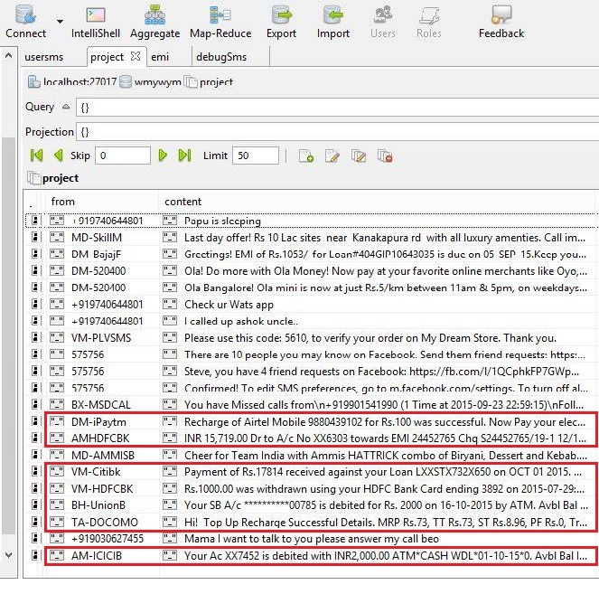
Messages of our interest are marked Red.

Slide 10
Attribute Extraction using Data Mining
We are interested in some specific types of messages :
Recharge Transactions.
Bank Credit and Debit Transaction.
EMI transactions if loan taken.
Extraction of those transactions is done by defining rules which we have done by using “regex”.

Slide 11
Recharge Transaction Analysis: FROM: AX-AIRMTA “Recharge with Rs18 from any airtel Retailer & enjoy 150 Local SMS for 14 days.” From: DM-iPAYTM “Recharge successful for Rs 200.00 .Talktime Credited: Rs 200.00, Processing Fee: Rs -22.00, Service Tax: Rs 22.00. Current Balance: Rs 200.01. Validity : 29-Dec-37” From: AM-iPAYTM “Hi There! Recharge of Airtel Mobile 9880439102 has been submitted to AirTel. However, AirTel is taking time to process your recharge. You will either receive recharge in next 2-3 hours, or your amount will be refunded in your Paytm wallet.” It can be observed that all the successful recharge messages have word “Recharge” followed by “successful” in common.

Slide 12
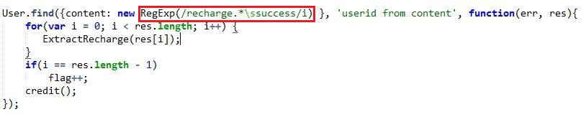

So, we used the regex : new RegExp(/recharge.*\ssuccess/i) case insensitive for targeting the specific messages.
And for parsing the amount being recharged we used the
regex : /(Rs|MRP|RC)\.?\s?\d+\.?\d*/ as shown below:

Slide 13
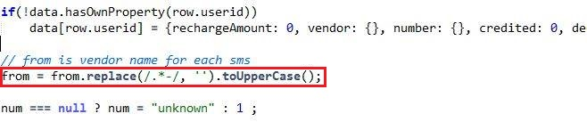

Vendor for each recharge could be found out by the “from” field of every SMS. Ex: AM-iPAYTM, DM-iPAYTM
All the recharge successful SMS also had the phone number that was recharged. So, we also parsed out the phone numbers for each user id.

Slide 14
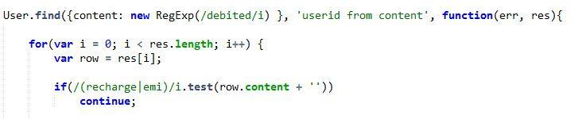

Debited Amount Analysis : All the messages containing the word “debited” were first selected and then out of those messages having “recharge” or “EMI” word were ignored for processing.
Then for each user id we summed up the amount debited.

Slide 15
PHASE: 3
Using various Data Mining Algorithms to classify Loan Risk Applicants.
Decision Tree
ANN(Artificial Neural Network)
KNN (K nearest neighbours)
SVM (Support Vector Machine)

Slide 16
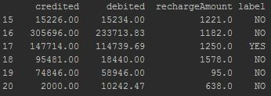
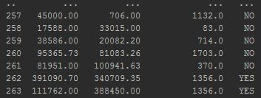
DATASET

Slide 17
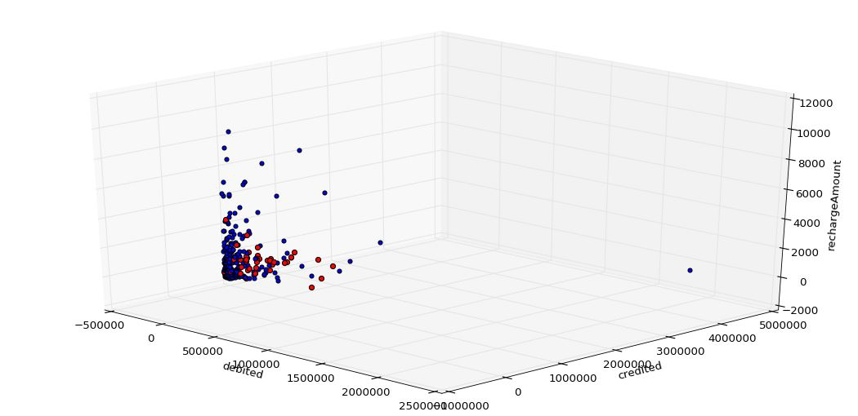
IMAGE-1

Slide 18
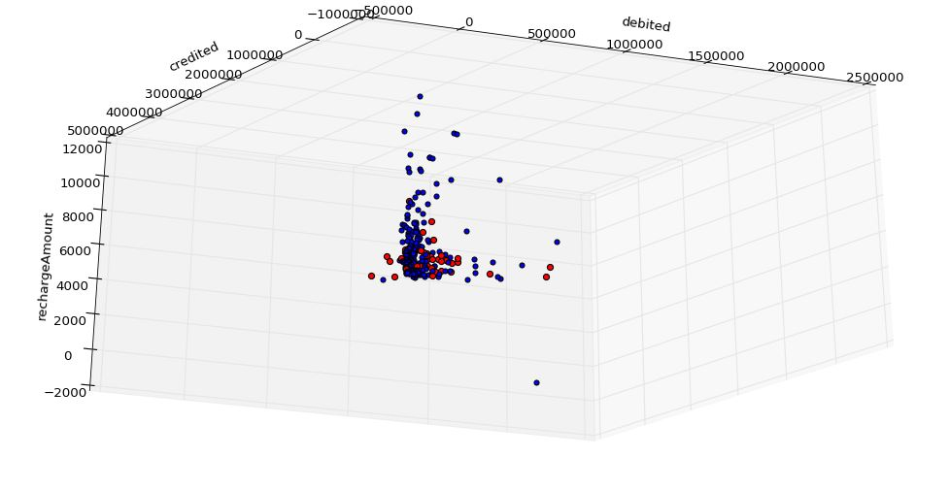
IMAGE-2

Slide 19
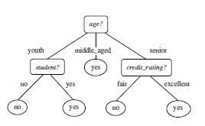
DECISION TREE
Decision tree induction is the learning of decision trees from class-labeled training tuples.
Decision trees can handle high dimensional data.
The learning and classification steps of decision tree induction are simple and fast.
In general, decision tree classifiers have good accuracy.

Slide 20
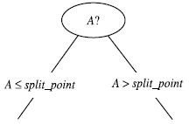



GINI INDEX
It’s a measure of Impurity, used in CART.
For Continuous valued attributes midpoint between each pair of (sorted) adjacent values is taken as a possible split-point.
The point giving the minimum Gini index for a given (continuous-valued) attribute is taken as the split-point of that attribute
The attribute that maximizes the reduction in impurity (or, equivalently, has the minimum Gini index) is selected as the splitting attribute.

Slide 21
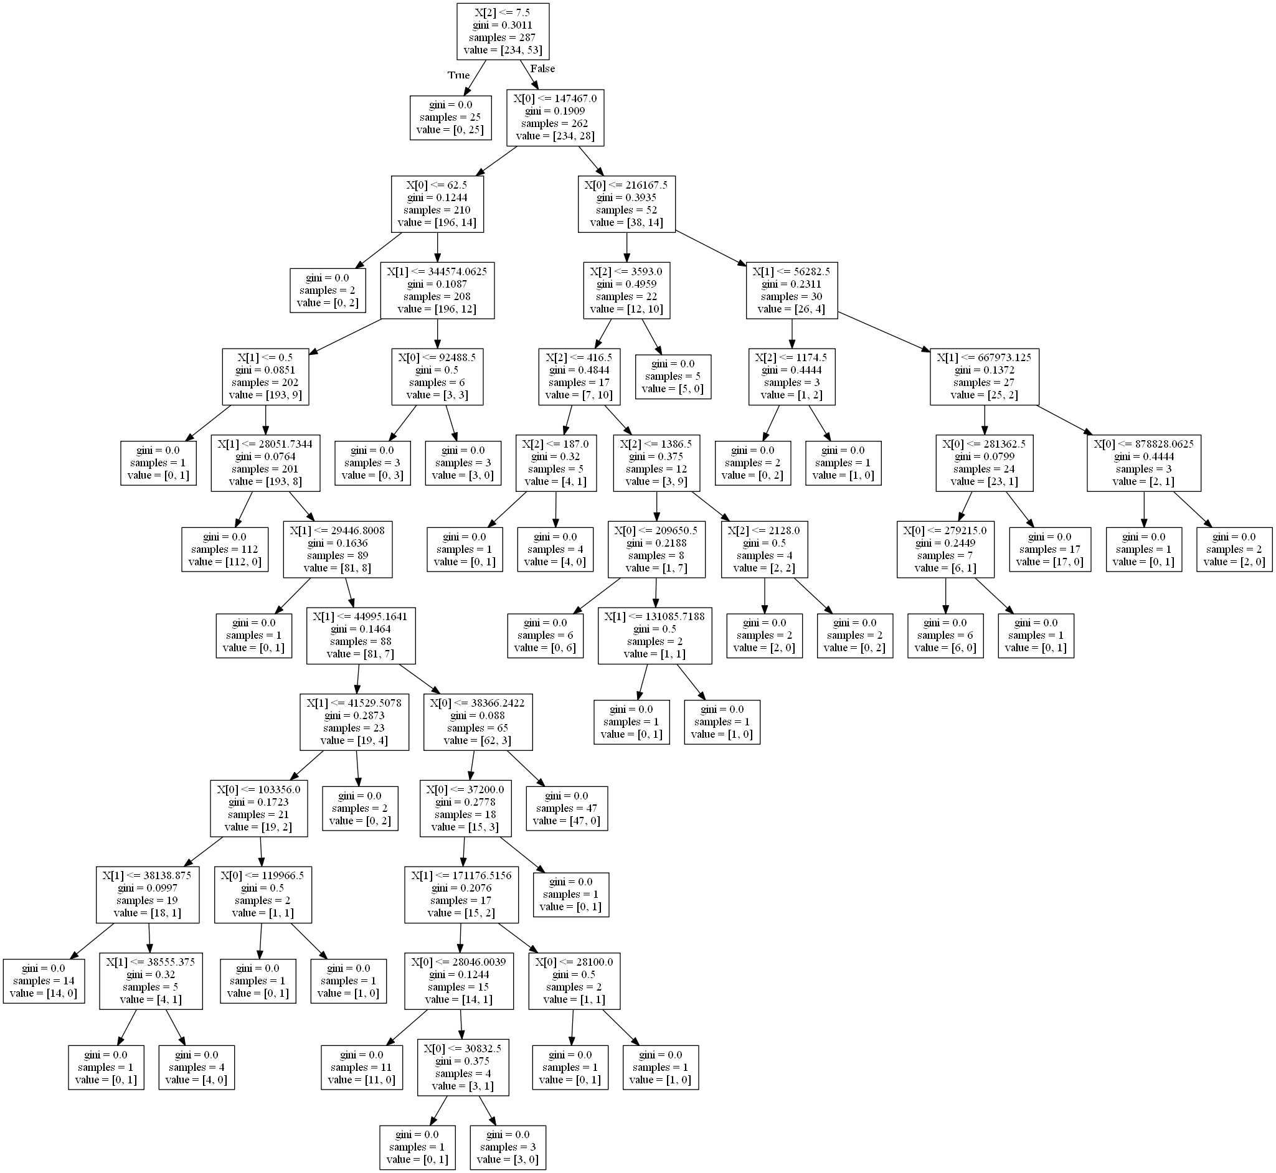
DECISION TREE CREATED OUT FROM
DATA SET
We have selected the attribute with minimum
Gini index value to split the data.
It works best when no of classes is small. In
Out case we have just two.
We stop when all the tuples belong to same
Class with gini index or impurity value 0.

Slide 22


CROSS VALIDATION ACCURACY:
We have take k = x here, i.e. we are diving our data randomly into random chunks of
x partition and cross validating output by taking five partition as Training data and
1 partition as testing data.
K = 5 Average percentage = 81.35 %
K = 6 Average percentage = 82.7 %

Slide 23
Proposed Approach using ANN
Step 1st : Dynamic Node Creation
Step 2nd : Weight Freezing based constructive algorithm
Step 3rd : Network Training and Pruning

Slide 24
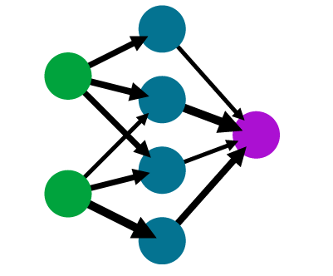
Dynamic Node Creation
Problem :
Solution:
Number of Hidden units cannot be determined in the beginning.
It typically depends on the complex relationship between the attributes.
The proposed approach starts with a single hidden node. It then constructs the network dynamically one node at a time.
The algorithm stops only when the error between successive steps becomes small.

Slide 25
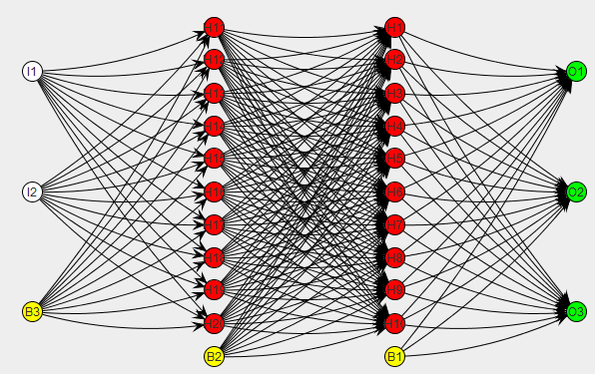
Weight Freezing
Problem :
Solution:
The number of training epochs required to train a neural network are typically large.
One approach for reducing the number of weights to be trained is to train few weights rather than all weights in a network and keep remaining weights fixed, commonly known as weight freezing.

Slide 26
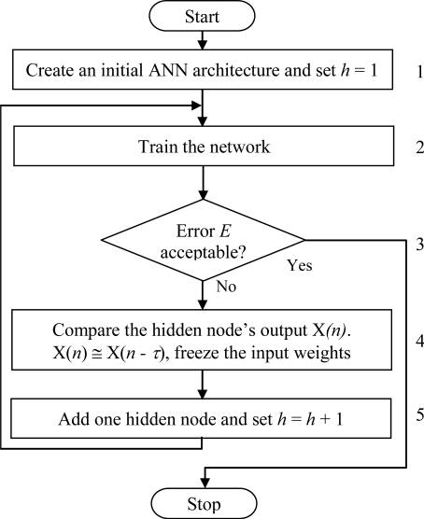
Constructive Weight Freezing
The idea behind the weight freezing-based constructive algorithm is to freeze input weights of a hidden node when its output does not change much in the successive few training epochs.
Weight freezing method can be considered as combination of the two extremes: for training all the weights of ANNs and for training the weights of only the newly added hidden node of ANNs.

Slide 27
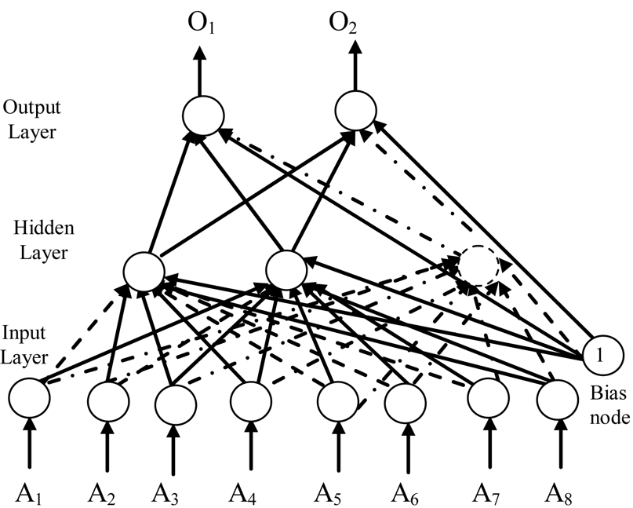
Pruning
Problem :
Solution:
As the number of hidden nodes in Hidden Layer increases the neural network tend to become complex for human interpretation.
Pruning offers an approach for dynamically determining an appropriate network topology. The technique begin by training a larger than necessary network and then eliminate weights and nodes that are deemed redundant.
Remove connections between input nodes and hidden nodes and between hidden nodes and output nodes.

Slide 28
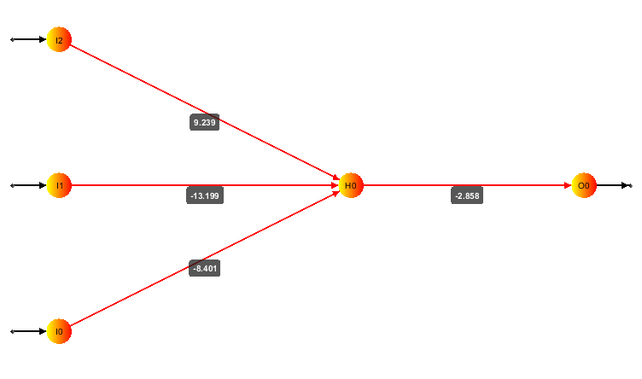
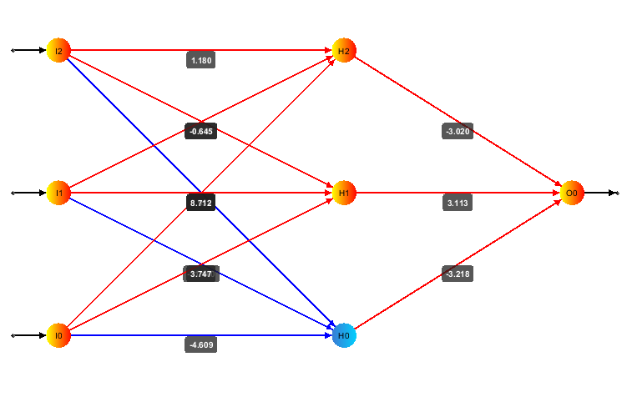
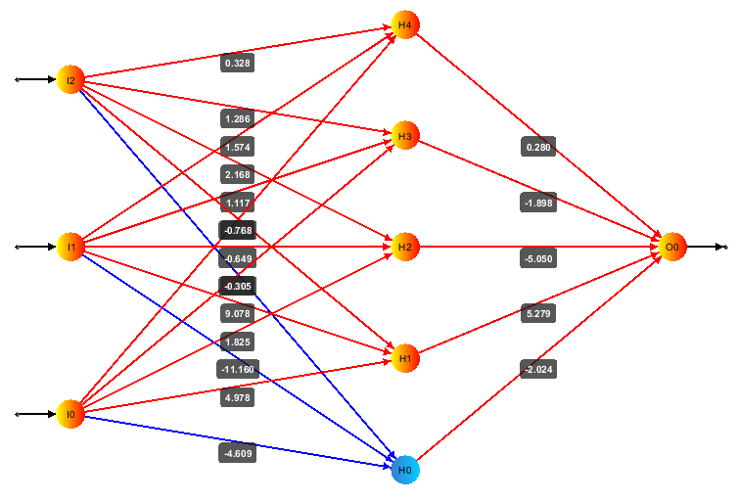
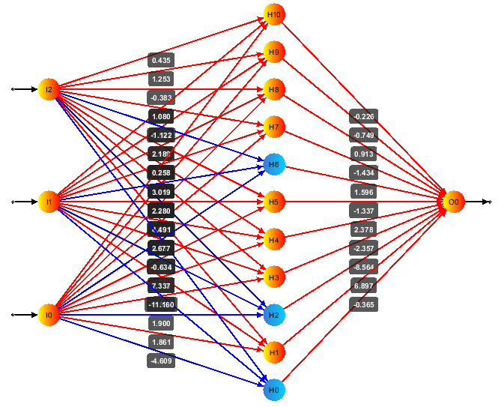
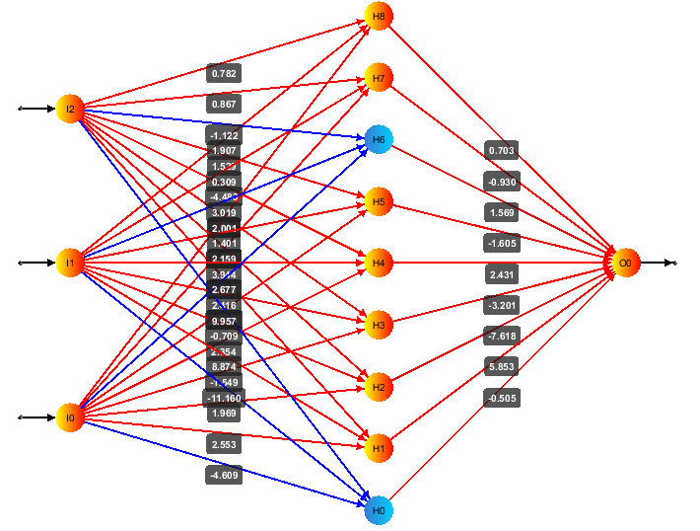
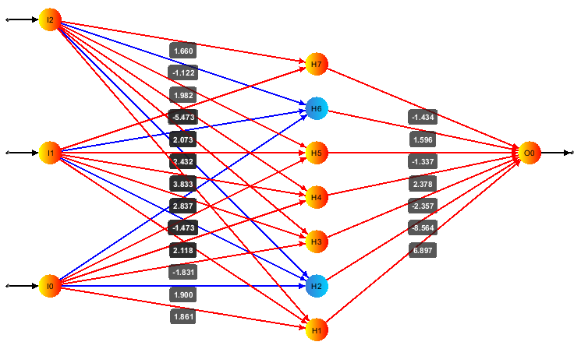
Neural Network at different epochs:

Slide 29
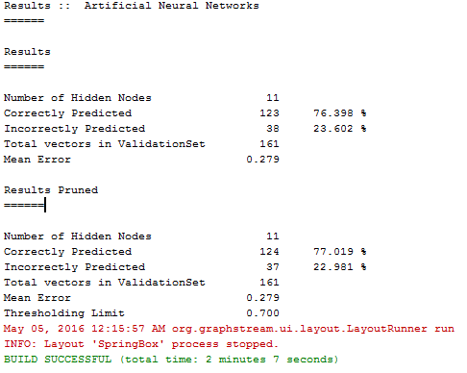
Results of ANN Classification:

Slide 30
KNN (K-nearest neighbors)
K-NN is simplest machine learning algorithm.
k-NN is a type of instance based learning, or lazy learning i.e.it doesn’t run computations on dataset until you give it a new datapoint you are trying to test
Classification is computed from a simple majority vote of the nearest neighbors of each point i.e by Equal weight or Distance weight
Equal Weight: Each KNN neighbor has equal weight
Equal Distance: Each KNN neighbor’s vote is based on distance
We used KNeighborsClassifier which implements learning based on the k nearest neighbors of each query point , where k is an integer value specified by the user.

Slide 31
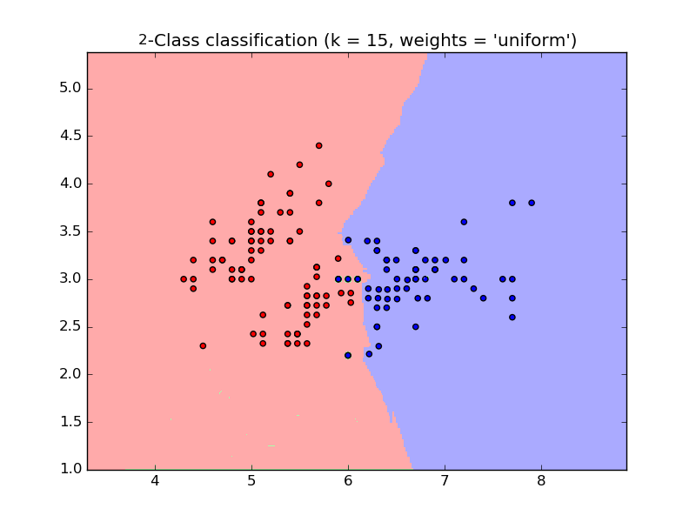
Contd..
Figure 2: 2 Classification result based on KNN with k = 15 and weights = ‘uniform’.

Slide 32



Accuracy Results of K-NN
For k = 4: Average Accuracy : 79.5%
For k = 5: Average Accuracy:79%
For k = 6: Average Accuracy:79.16%

Slide 33
SVM(Support Vector Machine)
Support vector machines are supervised learning.
It uses a non linear mapping to transform the original training data into a higher dimension.
With that non linear mapping , data from 2 classes can always be separated by hyperplane, which we find using support vectors.
SVMs can efficiently perform a non-linear classification using what is called the kernel trick, implicitly mapping their inputs into high-dimensional feature spaces.

Slide 34
Continued…
For non linear classification, RBF SVM is quite adaptive.
It uses RBF Kernel , which on two samples x and x’, represented as feature vectors in some input space is defined as:
where gamma is a parameter

Slide 35



Accuracy results of SVM:
For k = 4: Average Accuracy:66.25%
For k = 5: Average Accuracy:66%
For k = 6:Average Accuracy:66.16%

Slide 36
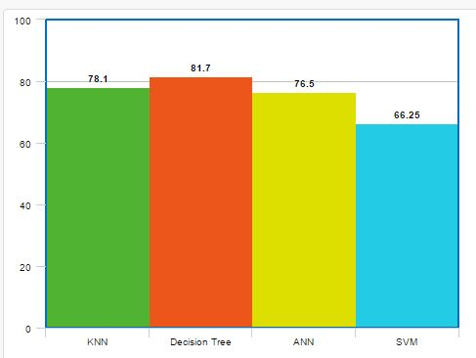
COMPARATIVE RESULT

Slide 37
6. Conclusions
We have successfully gathered Real Time user SMSes from various sources and preprocessed this raw data.
We have successfully extracted Key components 3Lac user SMSes and processed these attributes to create a useful data set.
We used this data set as our training data to train different Machine Learning Algorithms and analyzed their accuracies.
We did comparative study of accuracies of these alogrithms.

Slide 38
THANK YOU

